Slide 1
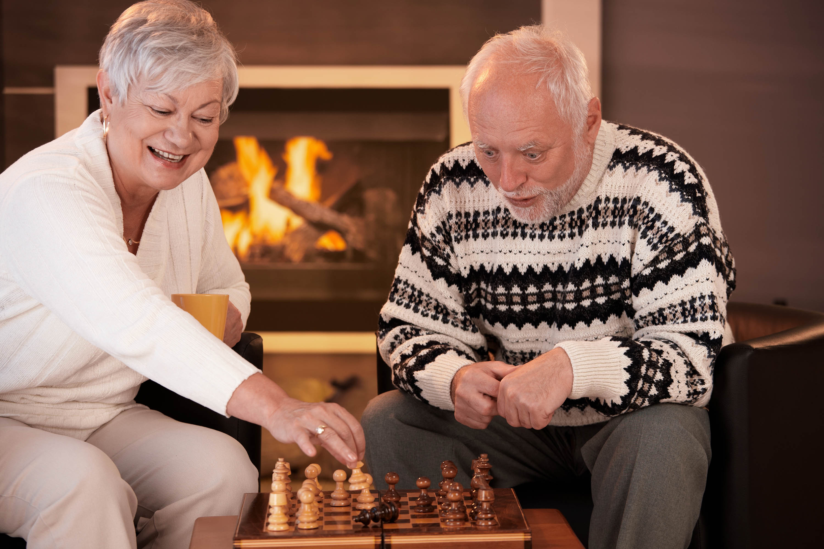
Chess Mining
Micha Birklbauer, BSc.
Dorian Karaban, BSc.

Slide 2
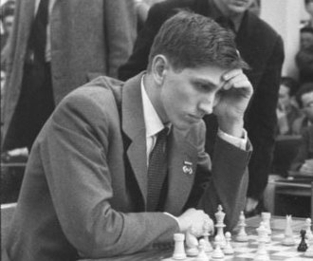
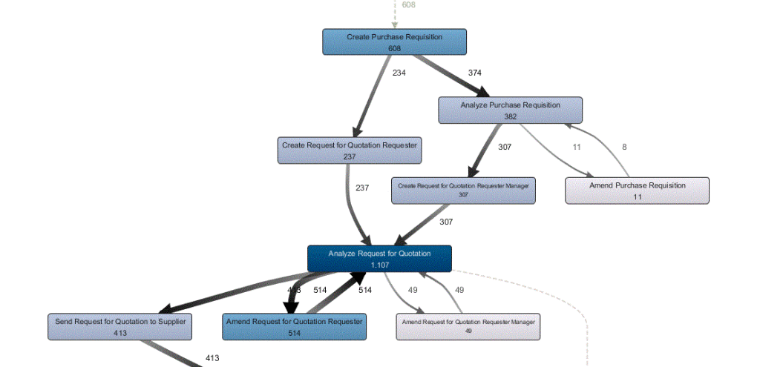
Overview & Goals
Although chess games do not necessarily have timestamps they are neatly ordered and can be expressed as sequence of moves.
In the following we suggest modelling chess games using process mining tools. We consider the following attributes:
Case ID: The match number
Activity: The move e.g. “e4”
Resource: White or Black
Timestamp: The current turn iteration
The goal is to compare openings - which we define as the first 10 turns - of different users and look for patterns in the generated process model as well as conformance between players.

Slide 3
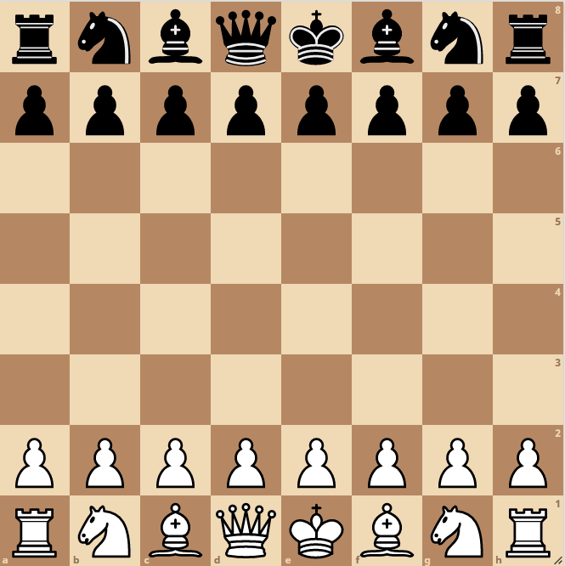
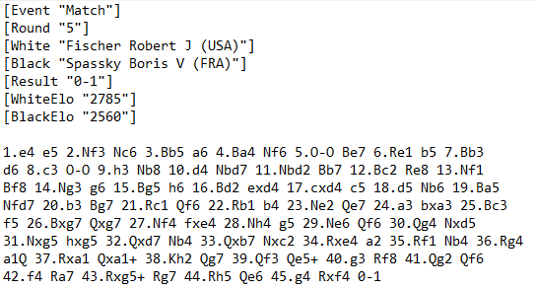
The Data
We are using matches from two different players - namely Dorian and Robert Fischer - as well as some popular openings scrapped from various websites like chess.com in standard pgn notation.
Example PGN:

Slide 4
Preprocessing
From PGN to Eventlog
Python:
package “chess.pgn” offers a convenient interface to read pgn files
we manually convert every match into a series of moves and save them as json
finally we convert the json to csv where we assign to every move the match number, colour and turn iteration
R:
filtering rows for:
player
colour
turn iteration < 20 (10 turns/player)
Disco:
reading of csv and generating xes logfile

Slide 5
Methods
&
Results
Disco
directly-follows graphs
pm4py (python)
alpha miner, heuristic miner, inductive miner, petrinets, token-based replay, alignments
bupaR (R)
inductive miner, petrinets, alignments
ggplot2 (R)
heatmaps

Slide 6
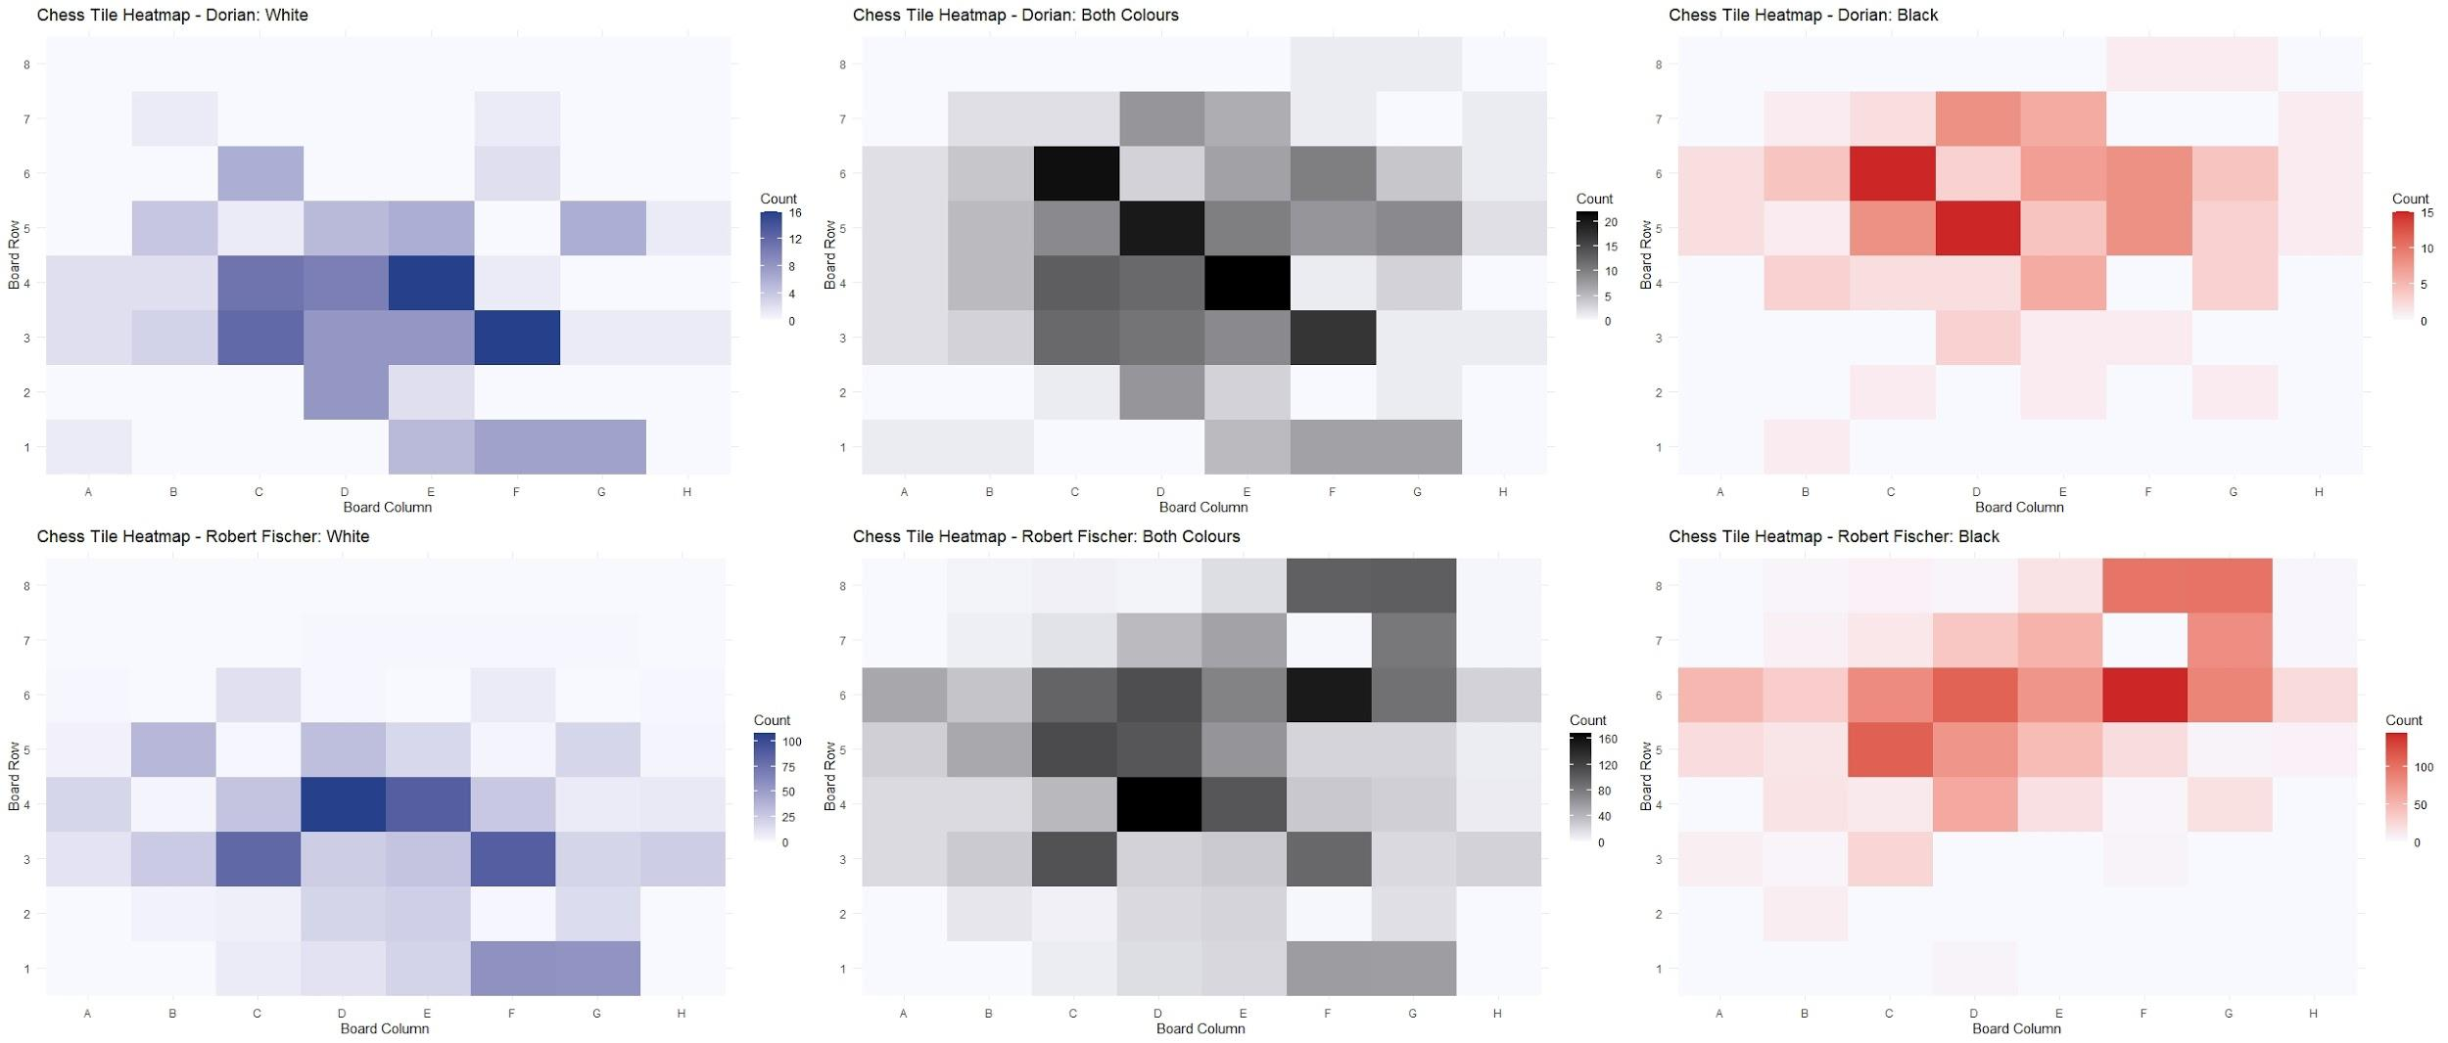
Comparing Tile Usage between Players

Slide 7
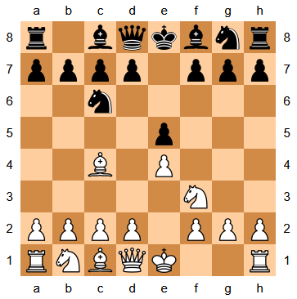
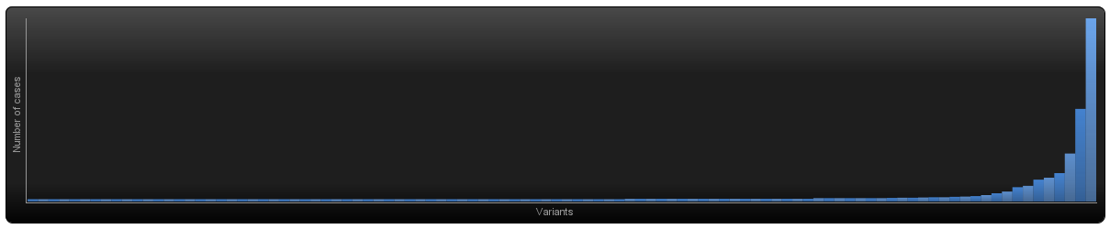
Discovery - Search the “Italian Game”
Datasource: Games selected by Chess Opening ECO Code
Grandmaster games: 2129
Elo: 1950-2851 [2482]
Code: C50-59 Giuoco Piano (Italian Game)
Goal:
Discover expected activities, e.g. <e4, e5, Nf3, Nc6, Bc4, ...>
Selection: Exceptional Games are defined as Noise
Cases: 2129
Variants: 204
Final Process Map Data:
Cases: 1581
Variants: 11

Slide 8
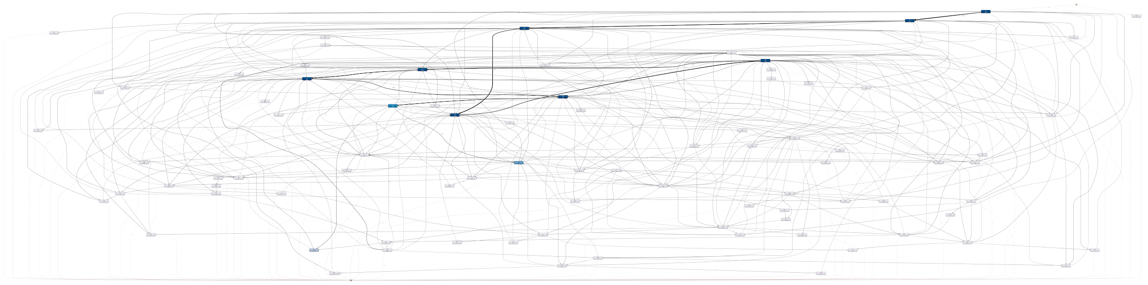


Slide 9
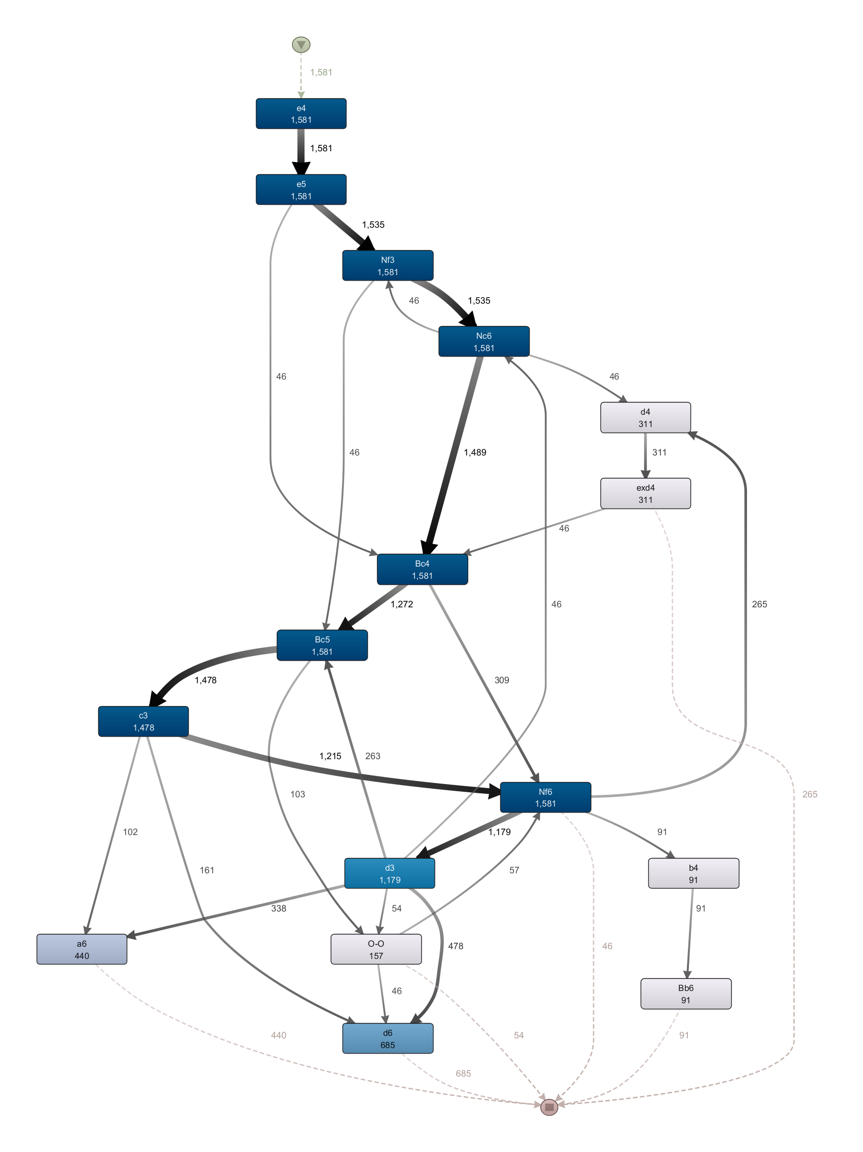
Limitations on Event Log:
Timestamp
Trace length must equal 10

Slide 10
Variants:
v1 (26.63%): <e4, e5, Nf3, Nc6, Bc4, Bc5, c3, Nf6, d3, d6>
v2 (21.38%): <e4, e5, Nf3, Nc6, Bc4, Bc5, c3 , Nf6, d3, a6>
v3 (16.76%): <e4, e5, Nf3, Nc6, Bc4, Bc5, c3, Nf6, d4, exd4>
v4 (7.27%): <e4, e5, Nf3, Nc6, Bc4, Nf6, d3, Bc5, c3, d6>
v5 (6.45%): <e4, e5, Nf3, Nc6, Bc4, Nf6, d3, Bc5, c3, a6>
v6 (5.76%): <e4, e5, Nf3, Nc6, Bc4, Bc5, c3, Nf6, b4, Bb6>
v7 (3.61%): <e4, e5, Nf3, Nc6, Bc4, Bc5, O-O, Nf6, d3, d6>
The sequence of the gray activities (e.g. e4,e5,...) can be found in 1390 (87, 86 %) games.

Slide 11
Variants:
v1 (26.63%): <e4, e5, Nf3, Nc6, Bc4, Bc5, c3, Nf6, d3, d6>
v2 (21.38%): <e4, e5, Nf3, Nc6, Bc4, Bc5, c3 , Nf6, d3, a6>
v3 (16.76%): <e4, e5, Nf3, Nc6, Bc4, Bc5, c3, Nf6, d4, exd4>
v4 (7.27%): <e4, e5, Nf3, Nc6, Bc4, Nf6, d3, Bc5, c3, d6>
v5 (6.45%): <e4, e5, Nf3, Nc6, Bc4, Nf6, d3, Bc5, c3, a6>
v6 (5.76%): <e4, e5, Nf3, Nc6, Bc4, Bc5, c3, Nf6, b4, Bb6>
v7 (3.61%): <e4, e5, Nf3, Nc6, Bc4, Bc5, O-O, Nf6, d3, d6>
The sequence of the gray activities (e.g. e4,e5,...) can be found in 1390 (87, 86 %) games.

Slide 12
Variants:
v1 (26.63%): <e4, e5, Nf3, Nc6, Bc4, Bc5, c3, Nf6, d3, d6>
v2 (21.38%): <e4, e5, Nf3, Nc6, Bc4, Bc5, c3 , Nf6, d3, a6>
v3 (16.76%): <e4, e5, Nf3, Nc6, Bc4, Bc5, c3, Nf6, d4, exd4>
v4 (7.27%): <e4, e5, Nf3, Nc6, Bc4, Nf6, d3, Bc5, c3, d6>
v5 (6.45%): <e4, e5, Nf3, Nc6, Bc4, Nf6, d3, Bc5, c3, a6>
v6 (5.76%): <e4, e5, Nf3, Nc6, Bc4, Bc5, c3, Nf6, b4, Bb6>
v7 (3.61%): <e4, e5, Nf3, Nc6, Bc4, Bc5, O-O, Nf6, d3, d6>
The sequence of the gray activities (e.g. e4,e5,...) can be found in 1390 (87, 86 %) games.

Slide 13
Variants:
v1 (26.63%): <e4, e5, Nf3, Nc6, Bc4, Bc5, c3, Nf6, d3, d6>
v2 (21.38%): <e4, e5, Nf3, Nc6, Bc4, Bc5, c3 , Nf6, d3, a6>
v3 (16.76%): <e4, e5, Nf3, Nc6, Bc4, Bc5, c3, Nf6, d4, exd4>
v4 (7.27%): <e4, e5, Nf3, Nc6, Bc4, Nf6, d3, Bc5, c3, d6>
v5 (6.45%): <e4, e5, Nf3, Nc6, Bc4, Nf6, d3, Bc5, c3, a6>
v6 (5.76%): <e4, e5, Nf3, Nc6, Bc4, Bc5, c3, Nf6, b4, Bb6>
v7 (3.61%): <e4, e5, Nf3, Nc6, Bc4, Bc5, O-O, Nf6, d3, d6>
The sequence of the gray activities (e.g. e4,e5,...) can be found in 1390 (87, 86 %) games.

Slide 14
Variants:
v1 (26.63%): <e4, e5, Nf3, Nc6, Bc4, Bc5, c3, Nf6, d3, d6>
v2 (21.38%): <e4, e5, Nf3, Nc6, Bc4, Bc5, c3 , Nf6, d3, a6>
v3 (16.76%): <e4, e5, Nf3, Nc6, Bc4, Bc5, c3, Nf6, d4, exd4>
v4 (7.27%): <e4, e5, Nf3, Nc6, Bc4, Nf6, d3, Bc5, c3, d6>
v5 (6.45%): <e4, e5, Nf3, Nc6, Bc4, Nf6, d3, Bc5, c3, a6>
v6 (5.76%): <e4, e5, Nf3, Nc6, Bc4, Bc5, c3, Nf6, b4, Bb6>
v7 (3.61%): <e4, e5, Nf3, Nc6, Bc4, Bc5, O-O, Nf6, d3, d6>
The sequence of the gray activities (e.g. e4,e5,...) can be found in 1390 (87, 86 %) games.

Slide 15
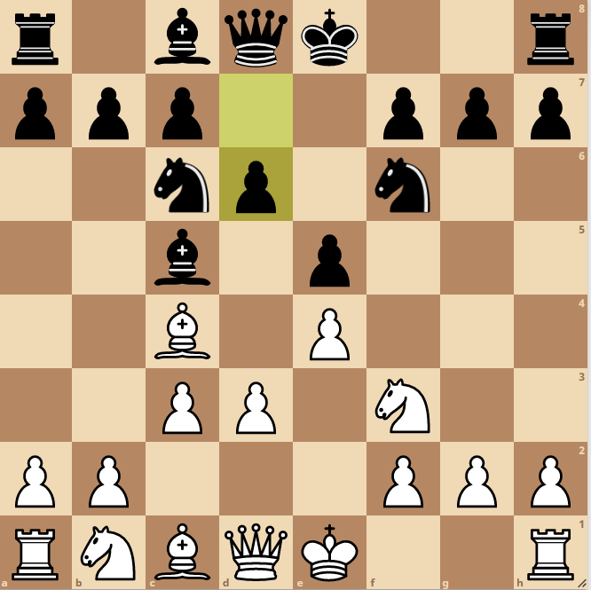

v1 (26.63%) C53 Italian Game: Classical Variation, Giuoco Pianissimo
v11 (2.91%) C53 Italian Game: Classical Variation, Giuoco Pianissimo (Trans. from C23-24)
Same product after last activity - Transposition
Notes:
Bishops game - Berlin Defense

Slide 16
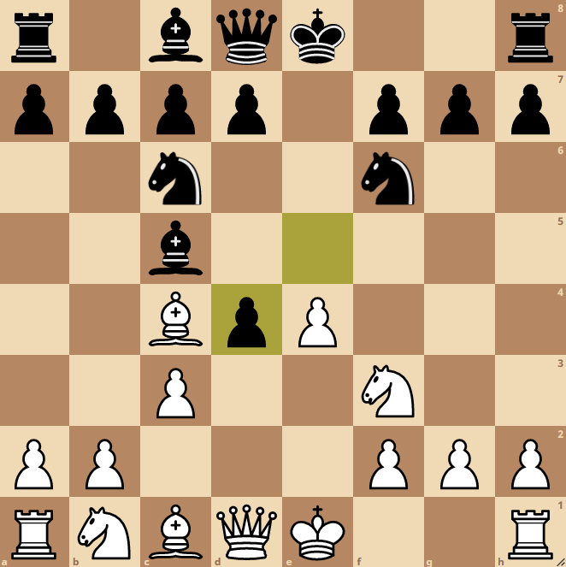
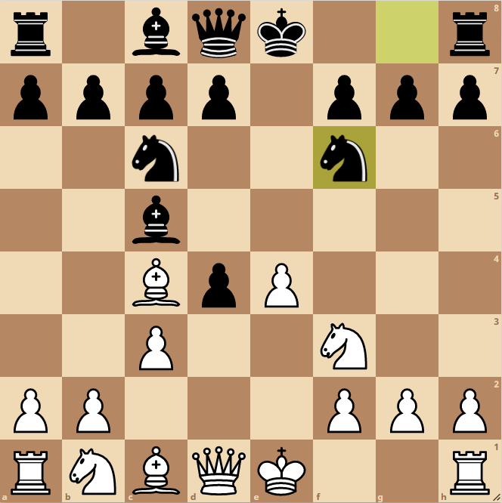
v2 (16.76%) C53 Italian Game: Classical Variation, Center Attack
v10 (2.91%) C44 Scotch Game: Haxo Gambit
Same product after last activity - Transposition
Notes:
Moves1.e4 e5 2.Nf3 Nc6 3.Bc4
Moves1.e4 e5 2.Nf3 Nc6 3.d4 exd4 4.Nxd4

Slide 17

Discovery Methods
Alpha Miner
Inductive Miner
Heuristic Miner

Slide 18
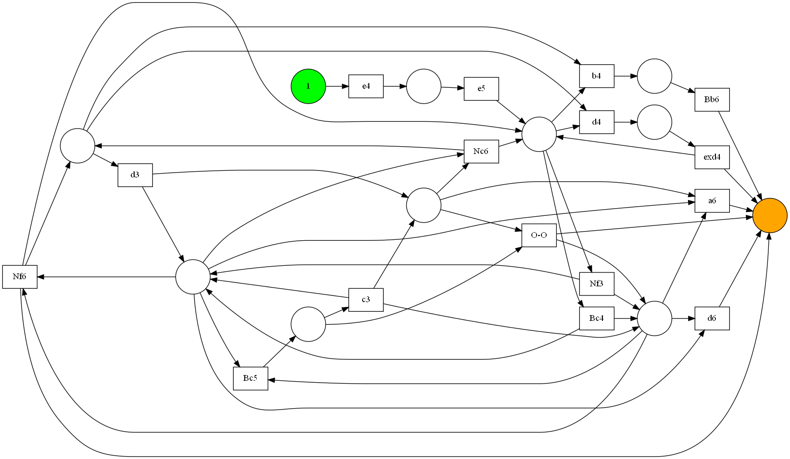

Slide 19
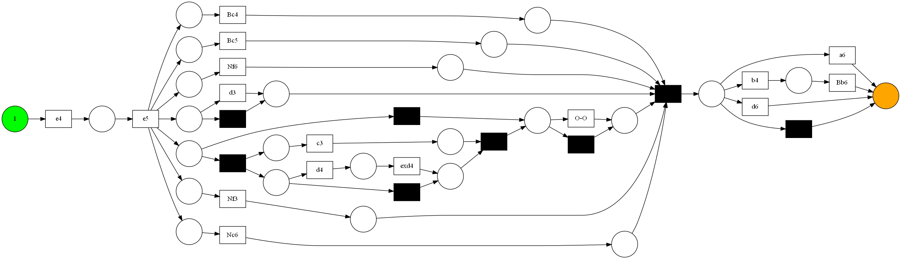
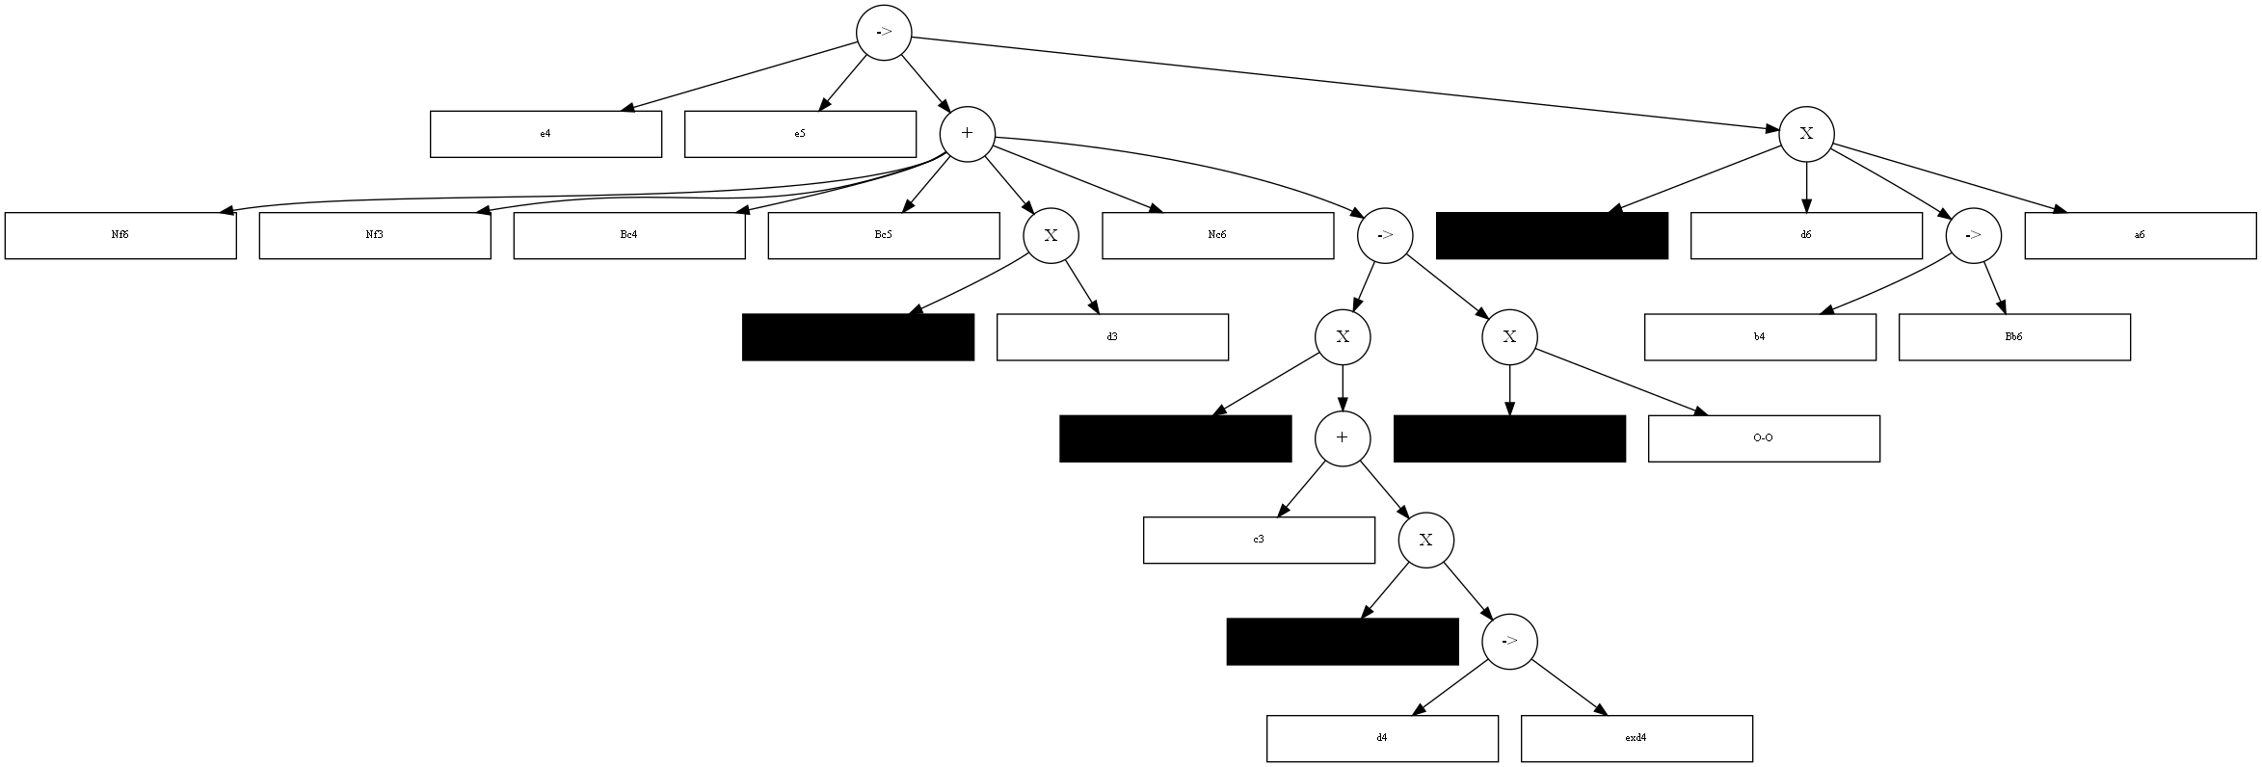

Slide 20
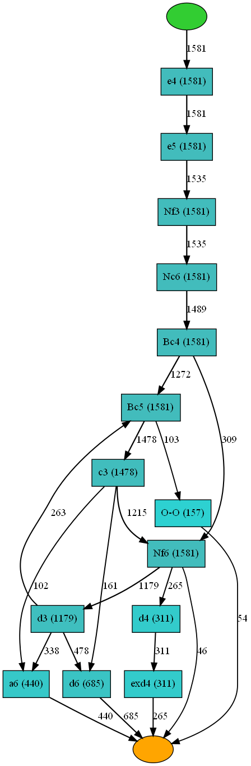

Slide 21
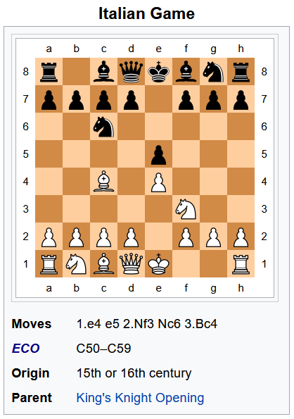
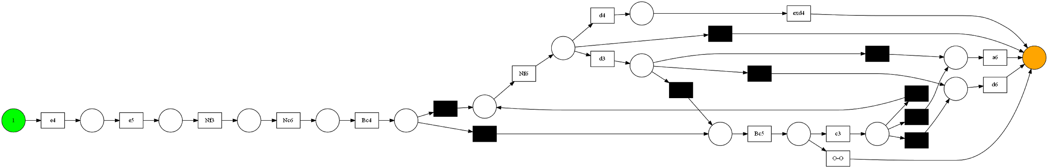
Heuristic Miner expresses the five expected activities in the petri net in correct order

Slide 22
Conformance - “Play like a Grandmaster”
ALPHA M. | Eventlog (1581) | Small Snapshot (~20) | Italian Games (~90)
Token based replay | 0.843 | 0.629 | 0.726
Alignement | 0.611 | 0.391 | 0.477
INDUCTIVE M.
Token based replay | 1.000 | 0.691 | 0.784
Alignement | 1.000 | 0.558 | 0.786
HEURISTICS M.
Token based replay | 0.986 | 0.680 | 0.856
Alignement | 0.973 | 0.503 | 0.773

Slide 23
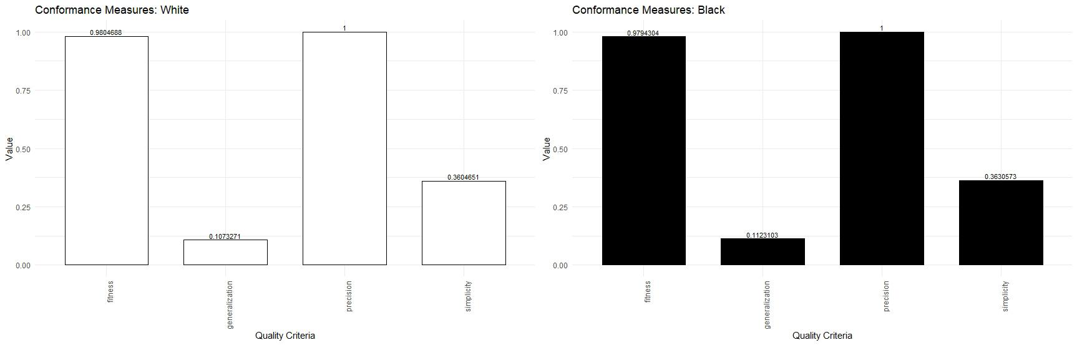
Conformance with Robert Fischer

Slide 24
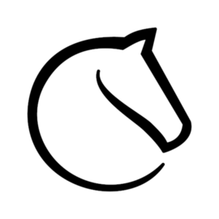





Thanks for watching

Slide 25
Images:
https://www.shutterstock.com/video/clip-31363114-not-approved-signed-red-ink-stamp-rubber
https://www.promineth.nl/wp-content/uploads/2016/01/Disco1-1024x495.gif
https://de.wikipedia.org/wiki/Bobby_Fischer

